Slide 1
Employee management
Normalization

Slide 2
Index
Need for Normalization
1st Normal Form
2nd Normal Form
3rd Normal Form
Conclusion

Slide 3
Need for Normalization
Normalization is the process of organizing data in a database.
It includes creating tables and establishing relationships between those tables according to rules.
Designed both to protect the data and to make the database more flexible by eliminating redundancy and inconsistent dependency.

Slide 4
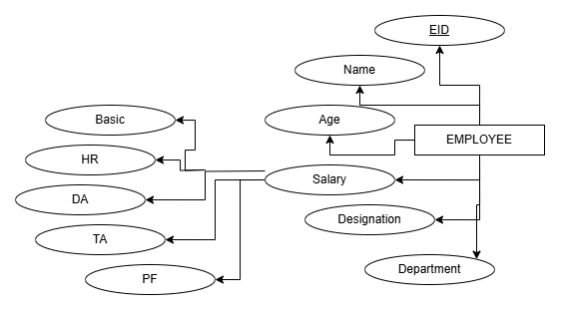
1NF
1st Normal Form or 1NF states that all the cell should only contain atomic values.

Slide 5
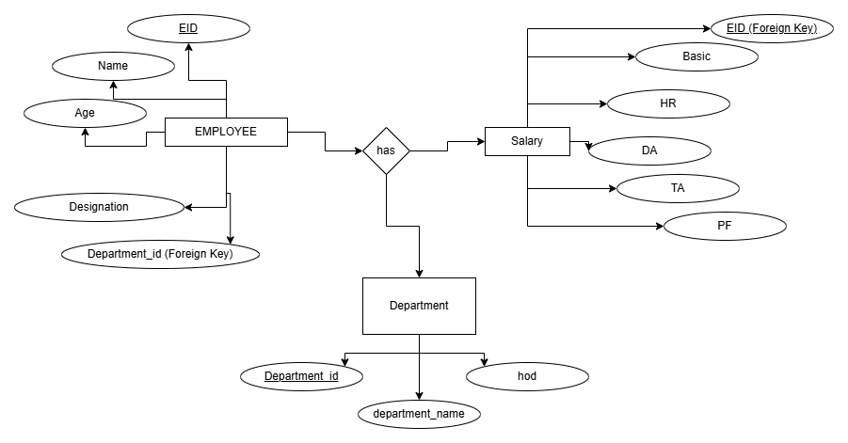
2NF
It is a way to organize a database table so that it reduces redundancy and ensures data consistency. For a table to be in 2NF, it must first meet the requirements of First Normal Form (1NF). Additionally, the table should not have partial dependencies.

Slide 6
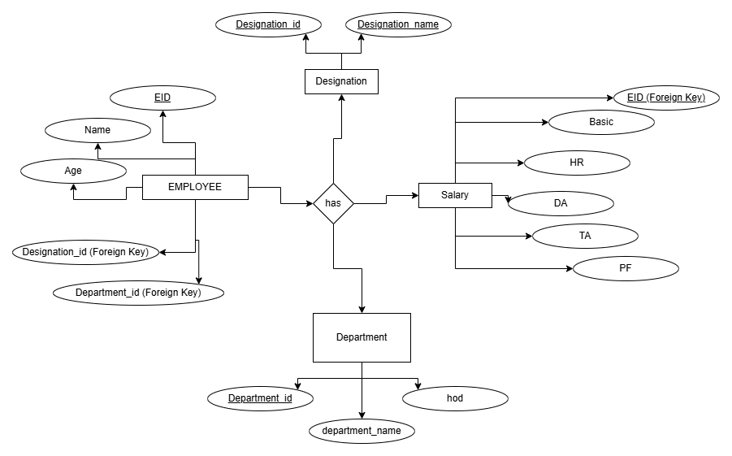
3NF
A relation is in the third normal form, if there is no transitive dependency for non-prime attributes as well as it is in the second normal form.

Slide 7
Conclusion
Improved Data Integrity: By normalizing the employee table up to 3NF, we eliminated data redundancy and ensured that each piece of information is stored in its most appropriate place. This helps prevent anomalies such as update, insert, or delete anomalies, which can lead to inconsistent data.
Reduced Redundancy: Normalization reduces unnecessary repetition of data, thus saving storage space and improving the efficiency of queries. Each table now only stores relevant data about employees and their relationships, making the database structure more streamlined and easier to maintain.
Enhanced Query Performance: With the normalization process, the data is better structured and organized. This results in more efficient queries and a clear separation of concerns, making it easier to scale the system or integrate with other databases in the future. By solving the problems of data duplication and inconsistency, the database becomes more reliable and effective for decision-making.

Slide 8

THANK YOU

